Slide 1
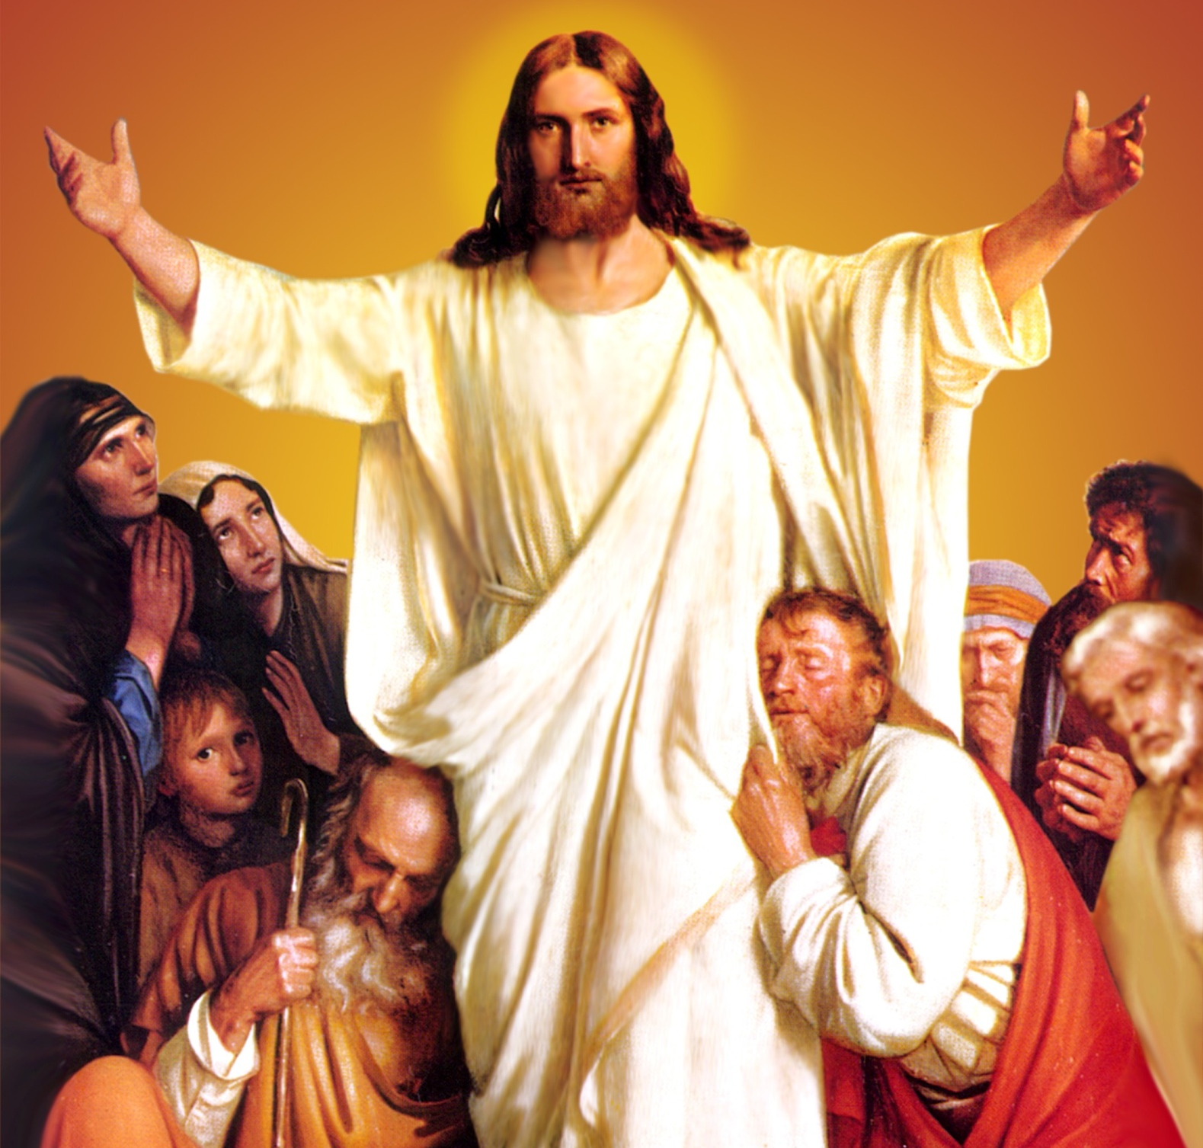
CATECHETICAL TEXTBOOK SERIES OF THE SYRO - MALABAR CHURCH
ON THE PATH OF SALVATION - 6
PEOPLE WHO
EXPERIENCED JESUS
6

Slide 2
LESSON 10
JESUS WHO TRIUMPHED OVER DEATH

Slide 3
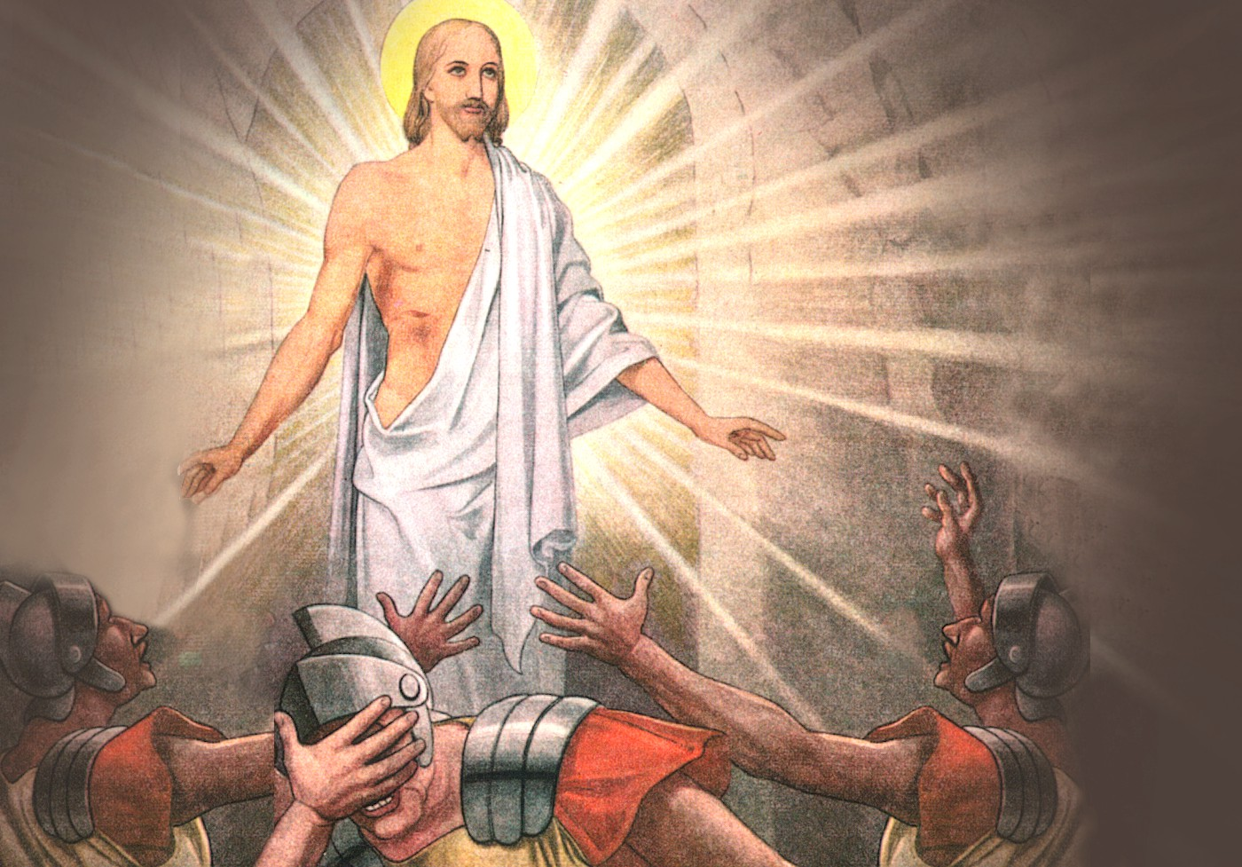
Jesus who died on the cross was buried in a tomb by Joseph of Arimathea, Mary, mother of Jesus and certain women. They had covered the body in linen clothes with spices as was the Jewish custom. Since Jesus had said that he shall rise on the third day, the Jewish leaders had the tomb sealed and a guard posted there with the permission of Pilate.

Slide 4
Early on Sunday, the first day of the week, Mary Magdalene and some other women went to the tomb to anoint his body. On the way they were asking one another, “Who will move the tomb stone for us?” When they reached the tomb there was a great earth quake. An angel of the Lord, descending from heaven rolled back the stone and sat on it. His appearance was like lightning, and his clothes white as snow. For fear of him the guards shook and became like dead men. But the angel said to the women, “Do not be afraid; I know that you are looking for Jesus who was crucified. He is not here, for he has been raised as he had said. Come; see the place where he lay” (Mt. 28: 2- 6). So they left the tomb quickly with fear and great joy to tell the disciples.

Slide 5
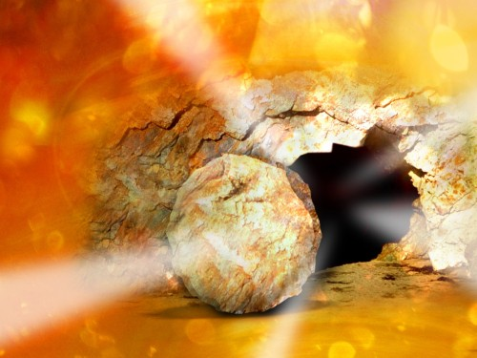
THE EMPTY TOMB
When the women told them this, Peter and John ran to the tomb. John reached there first. Peering inside, he saw the linen, but did not go in. Peter who followed entered the tomb. He saw the linen in one place and the head scarf alone in another. Then the other disciple also went in and they believed (Jn. 20: 4- 8). The empty tomb became a proof for resurrection. Jesus is the Son of God who defeated death and rose up in glory. Through his resurrection, Jesus manifested a glory that no one since creation can claim.

Slide 6
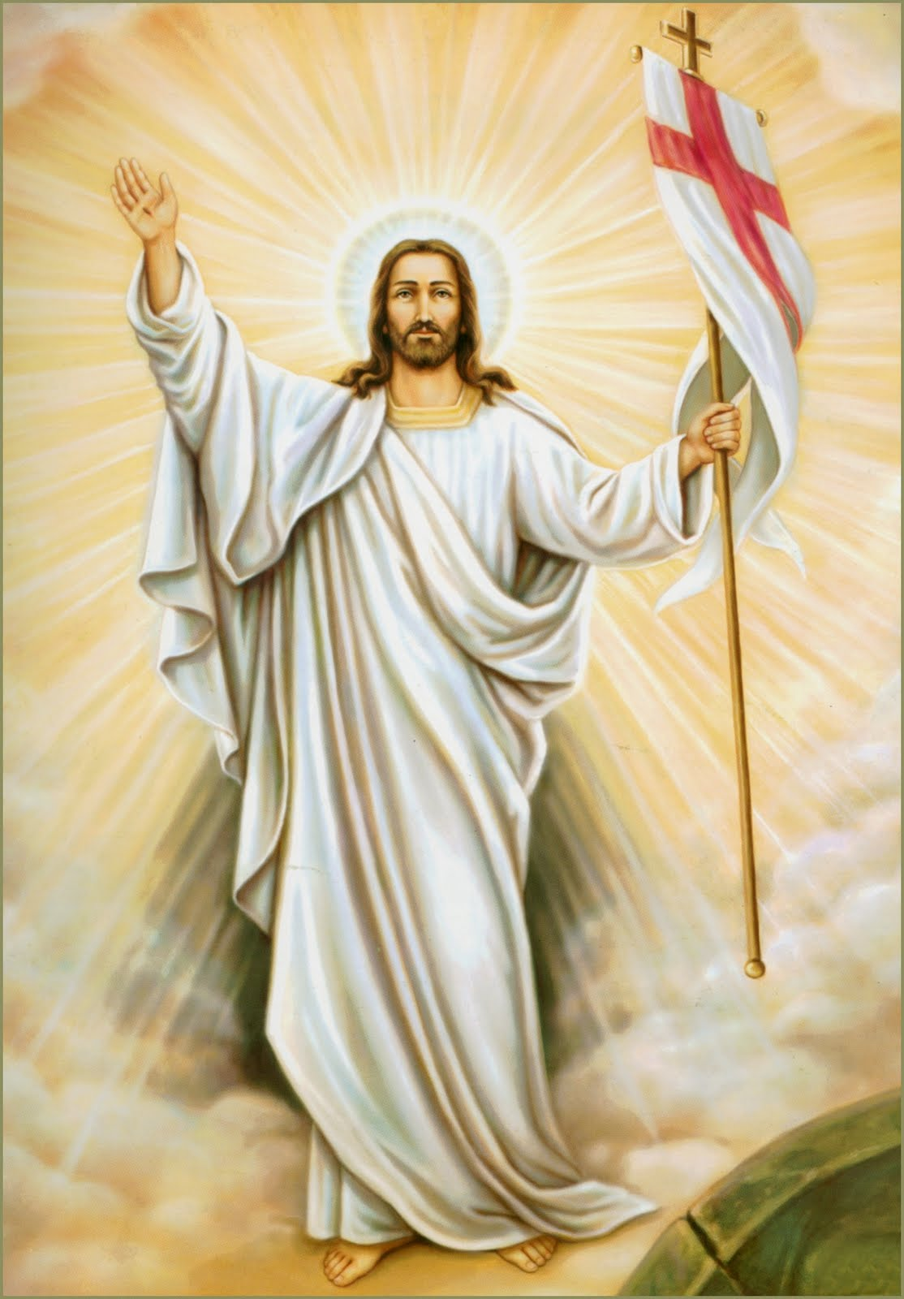
PROPHECIES
Jesus had foretold his resurrection. All three prophecies, that Jesus made about his death, end in the prediction of resurrection. “The Son of Man must undergo great suffering, and be rejected by the elders, chief priests and scribes, and be killed, and on the third day be raised” (Lk. 9: 22; Mk. 8: 31; 9: 31- 32; 10: 33- 34). Often in his teaching, Jesus used to speak about his resurrection.

Slide 7
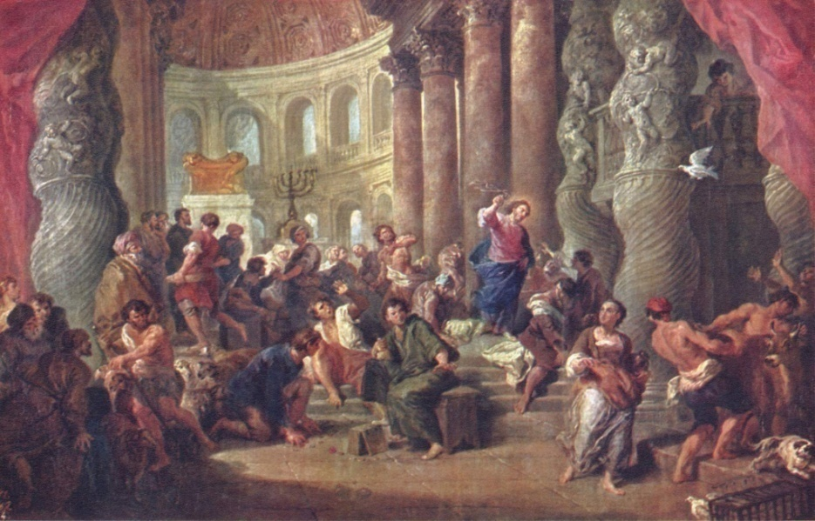
RENOVATING THE TEMPLE
Once Jesus entered the temple of Jerusalem. He was very infuriated by the sight of money changers, and those who sold cattle, sheep and doves. He made a whip of chords and drove them all out of the temple as he could not bear the pain of seeing his Father's house made into a market place. The Jews asked him, “What sign can you show to prove that you have authority to do this?” Jesus replied, “Destroy this temple; I shall rebuild it in three days” (Jn. 2: 19). Jesus said this about the temple that is his body.

Slide 8
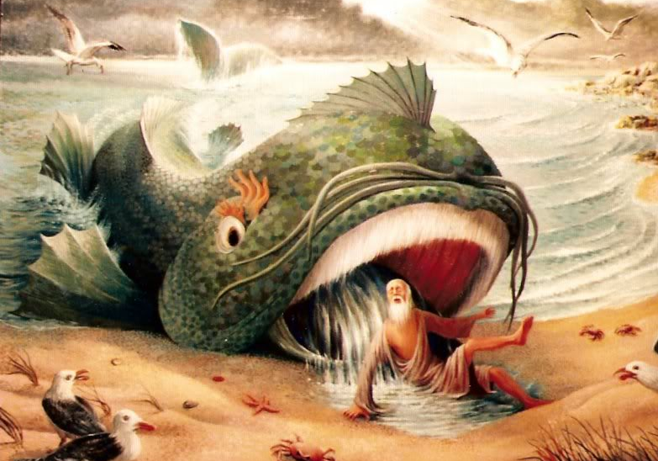
THE SIGN OF JONAH
Once some scribes and Pharisees went to Jesus and asked for a sign. Jesus gave them the sign of Prophet Jonah. The mission that God gave Jonah, one of the Old Testament prophets, was to go to Nineveh and preach for its conversion. But Jonah disliked the idea and boarded a ship to Tharsis instead. The sea became very rough. Realizing that Jonah was the cause of this, the sailors threw Jonah overboard. A whale swallowed him. After three days the whale vomited him on shore at Nineveh as the Lord commanded it (Jon. 1: 1- 2:10).
The sign that Jesus wanted to give the scribes and Pharisees was that he would be inside the earth for three days as Jonah was inside the whale. This indicates the three days that Jesus was in the Tomb. This also contains the hint that after the three days he shall rise.

Slide 9
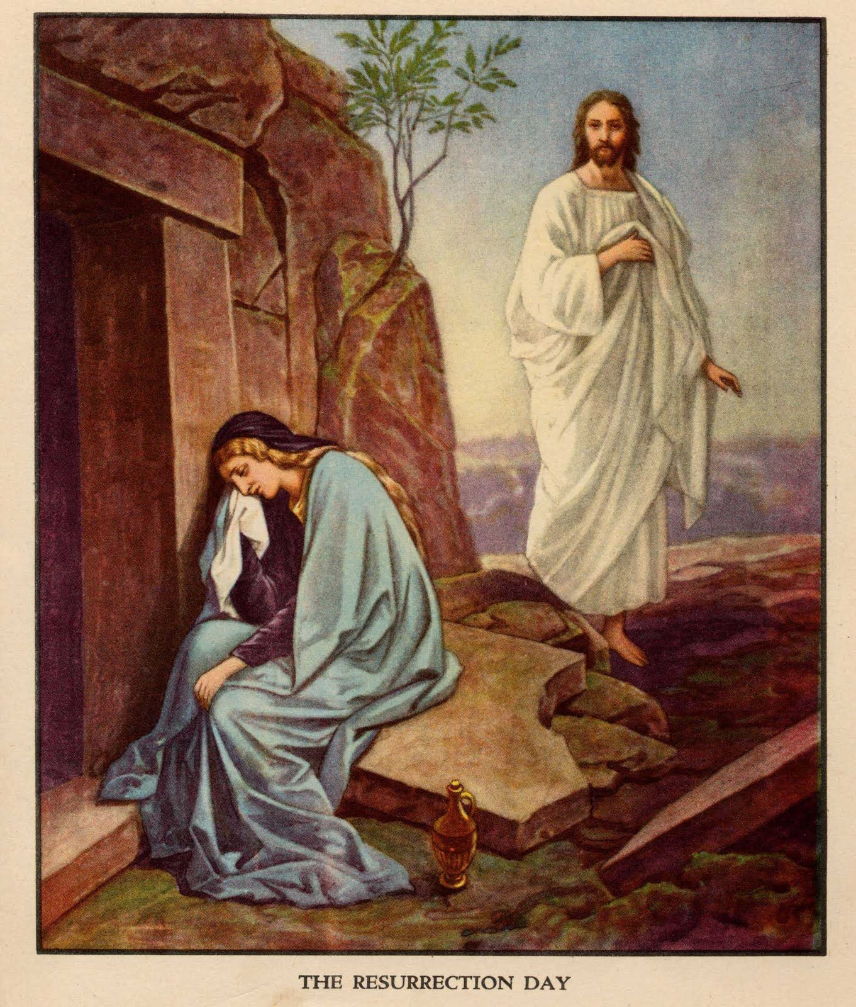
RISEN JESUS APPEARS
Jesus appears several times after the resurrection. The women who heard about the resurrection from the angel ran to tell the disciples. Then Jesus came towards them and greeted them saying, “Do not be afraid; go and tell my brothers to go to Galilee; there they will see me” (Mt. 28: 10.
Seeing the empty tomb, Mary Magdalene was weeping, not realizing that Jesus had risen from the dead. Then Jesus appeared to her. Even when he came near her and asked, “Woman, why are you crying”, she thought it was the gardener. But when he called her, 'Mary', she realized it was Jesus and said, 'Rabboni', which in Hebrew means, 'master‘.

Slide 10
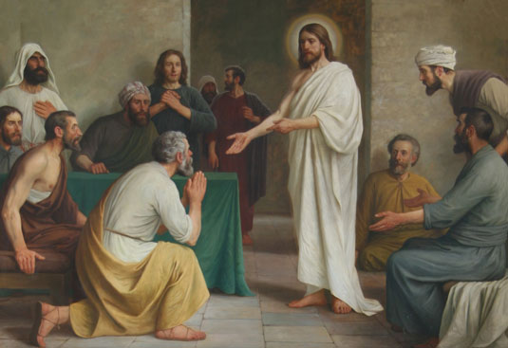
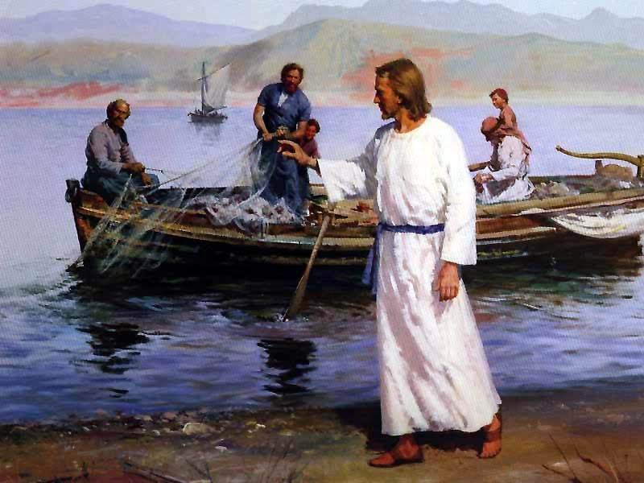
Jesus appeared twice to his disciples who were gathered in a closed room for fear of the Jews and greeted them saying, 'Peace be with you'. Later he appeared to his disciples on the shore of Lake Tiberius. (He even appeared to two of his disciples on the way to Emmaus.) Thus Jesus appeared to them on many occasions for forty days after the resurrection and taught them more of the Kingdom of God. Thus he gave them enough proof that he was alive.

Slide 11
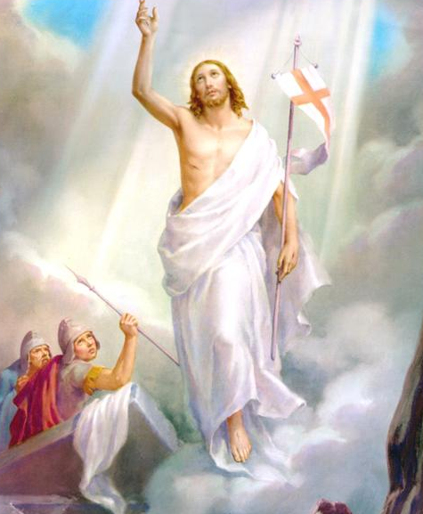
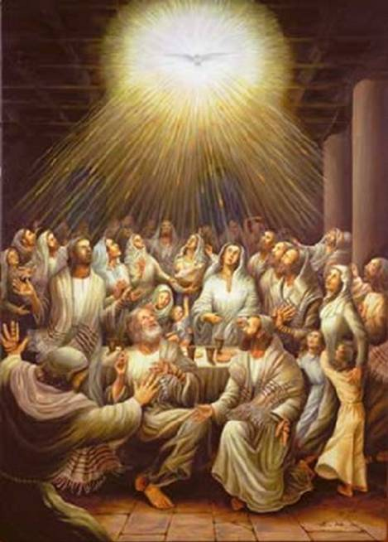
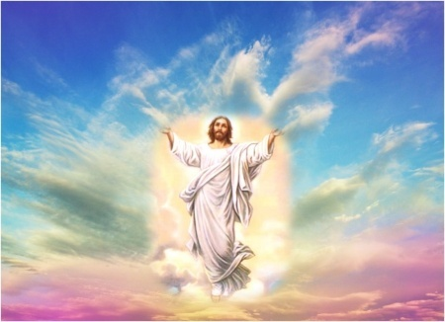
EASTER SEASON
In the liturgical year, the fifth period is the Easter season. This lasts from the great feast of Easter to the feast of Pentecost. In this season we praise Jesus who manifested the glory of God by conquering death by his glorious resurrection. The mysteries of salvation that we meditate upon during this period are, the resurrection of Jesus, the victory that he won over sin and death, the new life we got through the resurrection of Jesus, and the resurrection of Jesus as an assurance for our resurrection.

Slide 12
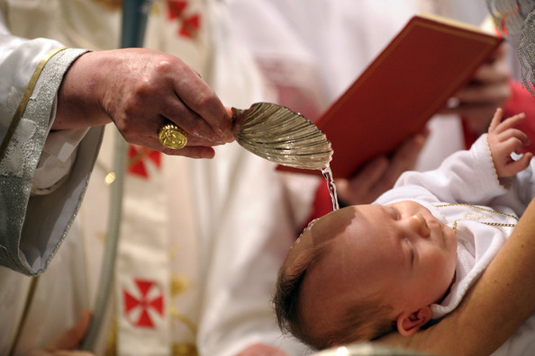
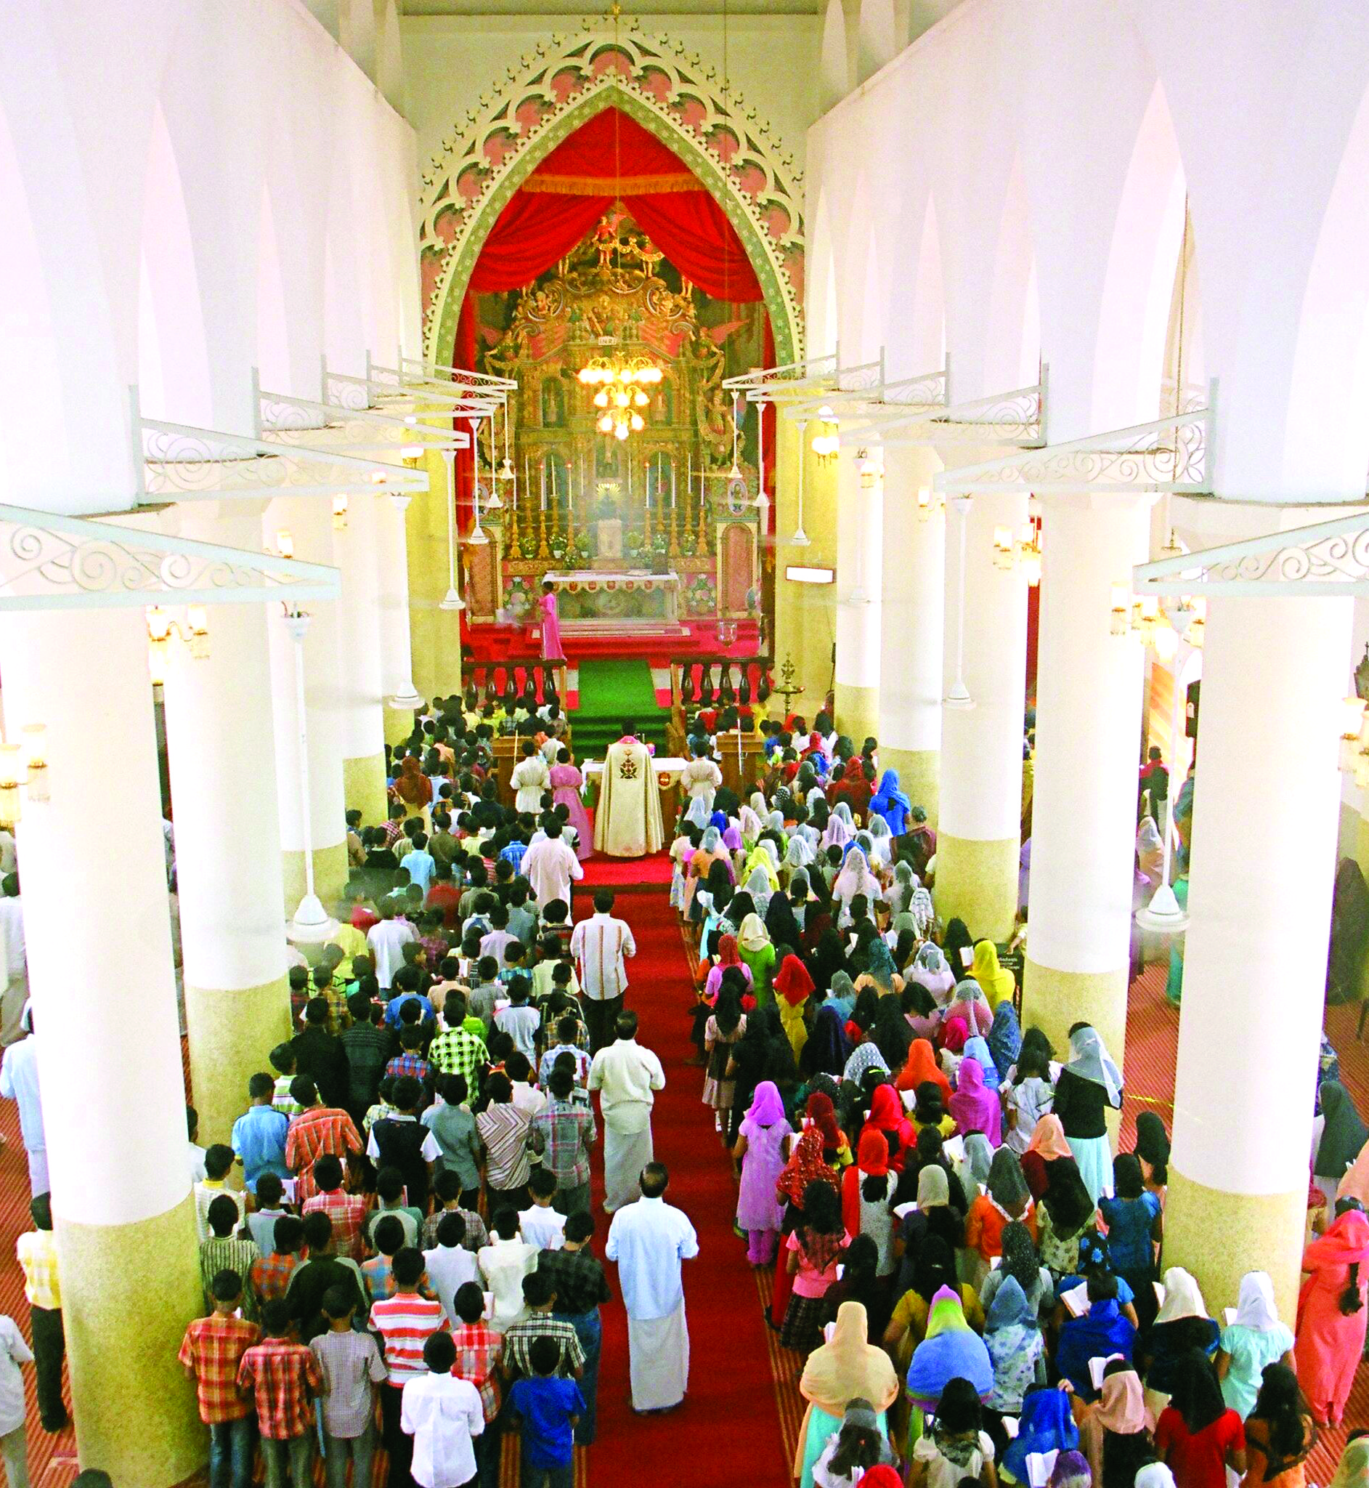
NEW SUNDAY (PUTHU NJAYAR)
The first Sunday after Easter is known as the New Sunday (Puthu Njayar in Malayalam). This is the Sunday when those who receive baptism on Easter participate fully. This is called the New Sunday because this is the day on which the experience of the new Christian life starts.

Slide 13
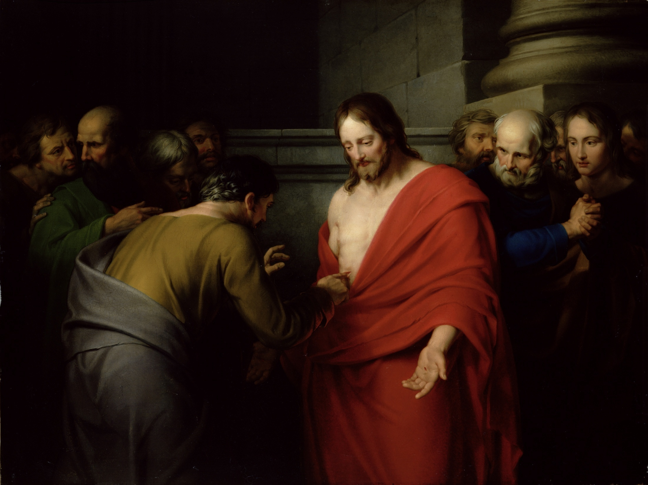
This is also the day on which we remember the appearance of risen Jesus to Thomas. Hence this is also known as St. Thomas Sunday. On that day there is also the practice of going on pilgrimage to certain holy places named after St. Thomas. Malayattoor is the most important among these pilgrim centers.
Let us try to lead a new life, dying to sin and being born again with Jesus who conquered death and sin by his resurrection.

Slide 14
Let us pray
O! Jesus, the way, the truth and the life, lead us who
rejoice in your resurrection, from darkness to light, from untruth to truth, from death to life.

Slide 15
Read the word of god:
John 20:1-21

Slide 16
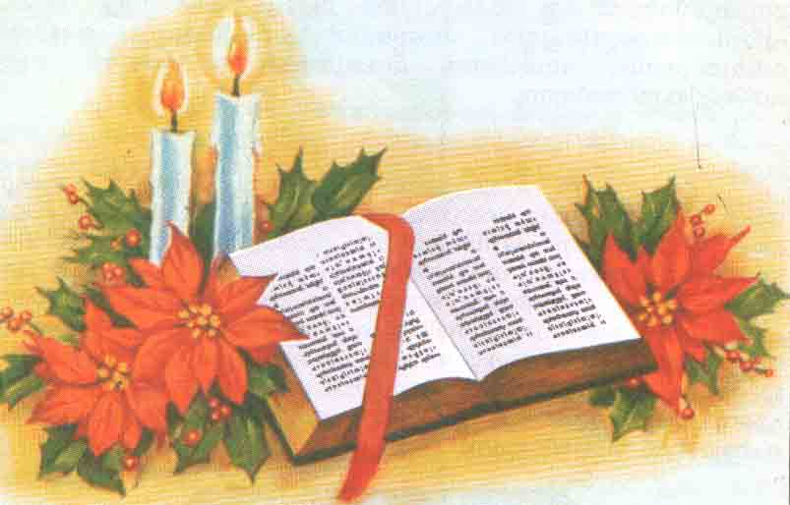
WORD OF GOD FOR GUIDANCE
"If Christ has not been raised, then our proclamation has been in vain and your faith has been in vain.’’ (1 cor. 15:14)

Slide 17
LET US DO:
Narrate the resurrection event of Jesus
based on the gospel of St. Luke.

Slide 18
MY DECISION
I will always praise the risen Lord remembering
his presence in me.

Slide 19
LET US Find out the answer
1. Why were guards posted at the tomb of Jesus?
2. Which temple did Jesus refer to when he said: "If you destroy this temple I will reconstruct it in three days"?
3. How was the sign of Jonah accomplished in Jesus?
4. What was the main evidence that proves the resurrection of Jesus?
5. Describe any one of the apparitions of Jesus after his resurrection?

Slide 20
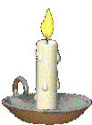
Thank you

